Slide 1




X
SmsDome – SingPost (Admail & HomeDirect)
Updated: 4th July 2024
SmsDome Pte Ltd
T: +65 6767 3663
F: +65 6354 1339
E: info@smsdome.com
A: 47 Jalan Pemimpin, Halcyon 2, #03-01, Singapore 577200

Slide 2
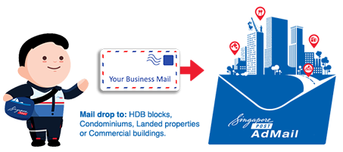
Advertising with Singapore Post
Singapore Post’s offers a mail drop service that delivers your marketing and promotional messages direct to households in Singapore.
Admail lets you deliver your message in 2 ways:
Admail
HomeDirect
Example uses:
Acquisition campaigns – ie. BOC credit cards
Product sampling – ie. Breeze detergent
Targeting at mass market – ie. KFC, Pizza Hut
Targeting at proximity of outlets – ie. Courts, AudioHouse

Slide 3
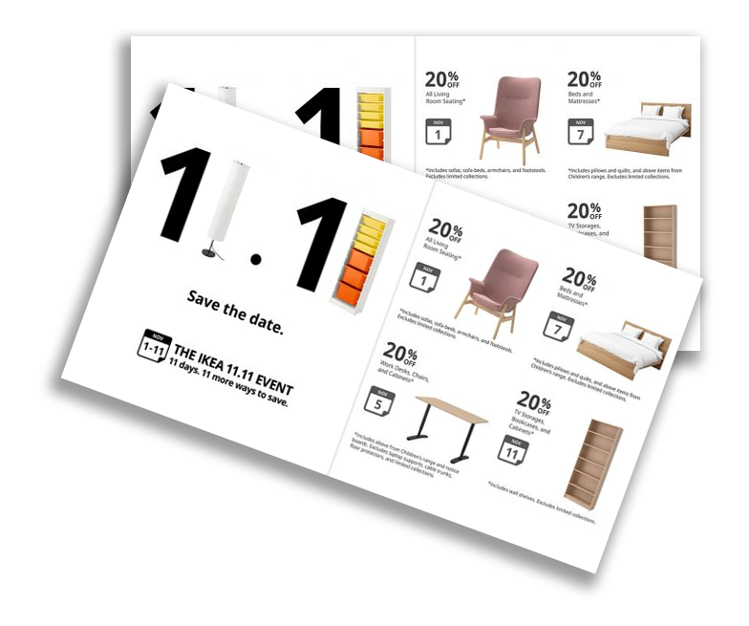
1. Admail
Admail is a cost-effective unaddressed mail drop service used for lead generation. Marketing collaterals will not have envelopes and are unaddressed.
What do we mean by unaddressed?
Unaddressed means there are no greetings/salutations such as: “The resident”
Size & weight specifications:
Size of the marketing collateral does not matter
Max weight of the first tier (cheapest) is 25g
Target by:
Sector
Dwelling type
Deliver to:
HDB
Condos / Landed
Commercial

Slide 4
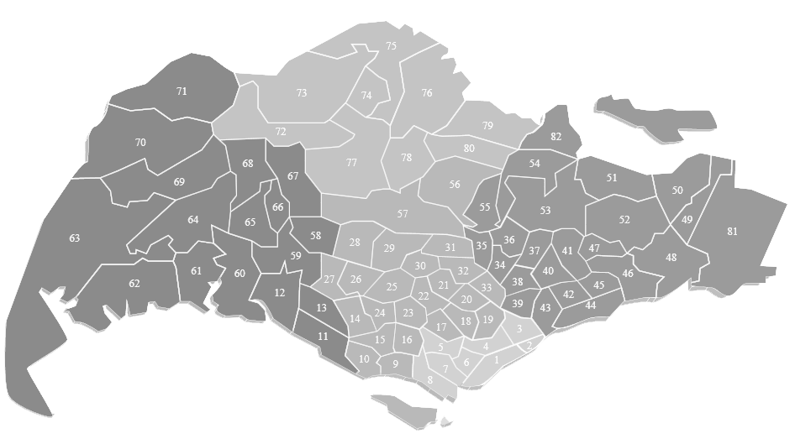
Admail: Targeting
1. By Sector
Sector is the first 2 digits of our 6-digit postal code.
eg: 520865 (52 is the sector code)
You can select multiple sectors to blast.
2. By Dwelling type:
HDB
Condo / Private / Landed properties
Commercial buildings
Note: Both ways can be used concurrently:
eg: Target Sector: postal code 43, HDB, condo and landed properties

Slide 5
Admail: Rates
Housing Type | Admail: Unit cost (Without printing) | Admail: Unit cost (With printing)
HDB | $0.08 (Non-peak period) $0.10 (Peak period) | Additional printing cost: $0.02 - $0.08 per copy (Depending on volume) A5 Size 2 printed pages (Front & back) 4C x 4C (Full colours on front & back) 128gsm Art card 2 weeks lead time for printing Printing rates subjected to change
Condominium | $0.16 (Non-peak period) $0.20 (Peak period)
Landed | $0.16 (Non-peak period) $0.20 (Peak period)
Commercial | $0.16 (Non-peak period) $0.20 (Peak period)
Distribution time required:
Peak-period: 10 working days
Non-peak period: 5 working days
Peak-period: October - January

Slide 6
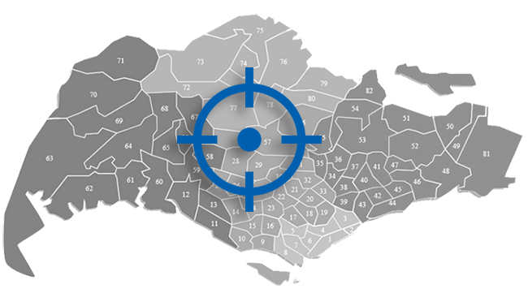
2. HomeDirect
HomeDirect is a semi-addressed direct marketing solution whereby your tailored messages are delivered to relevant households. Your mail is addressed to ‘the resident’, providing your marketing campaign with better personalization.
Target by:
Building type
Street level
Building name
Postal code
Condominium sector code
Radius
Housing categories
Mail specifications:
Semi Address Label
SingPost logo
Returned address (if applicable)
A5 envelope

Slide 7
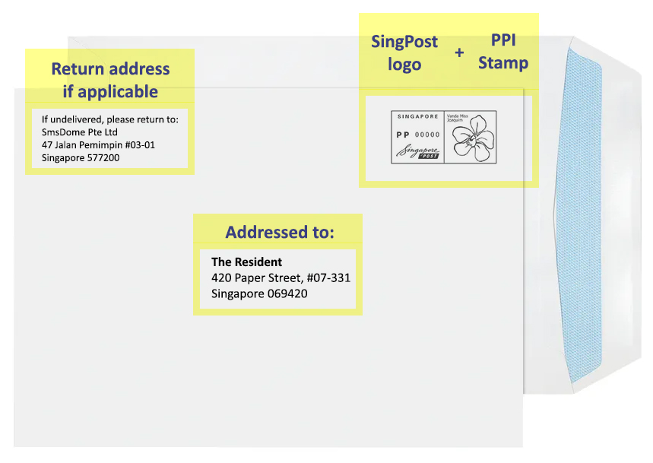

HomeDirect: Envelop details
SingPost’s envelope are white in color.
If you would like colorful or better-quality envelopes, you can provide your own to SingPost.
C5 size Envelop:

Slide 8
HomeDirect: Targeting & Rates
Standard |  |  | Enhanced
HomeDirect Plus | HomeDirect Street | HomeDirect Building | HomeDirect New | HomeDirect Radius | HomeDirect Living
Specific Condominium units | Street names, building description | Building names, postal codes | New residential units | Distance from postal code or building | Housing categories: Compact, Comfort etc.
Weight Not Exceeding | Standard | Enhanced
25g | $0.50 | $0.55
50g | $0.65 | $0.70
100g | $0.75 | $0.80
200g | $0.85 | $0.90
300g | $0.95 | $1.00
Rates cover cost of:
Postage
Printing and pasting of address label
Postage Paid Impression (PPI)
Non-window envelope
Transportation to BMC for lodgment
*Rates includes a C5 envelope. Differing rates applies to other sized envelopes
Minimum charge per posting is $1,000 before GST, with rates are subjected to prevailing GST.
Distribution time required:
Peak-period: 5 working days
Non-peak period: 3 working days
Notes:
# Singpost does not have any information about the companies occupying office units in office buildings. E.g. Asia Square has offices of various industries occupying their premises. Patricia wants to only target units that are occupied by financial institutions. Singpost do not have information about this.
* Public – private hybrid properties EC = executive condo HUDC = Housing and Urban Development Company, a property developer MGF = EMAAR MGF LAND LIMITED, a property developer

Slide 9
Admail & HomeDirect Comparison
 | Admail | HomeDirect
Envelope & Addressee | ✗ | ✓
Target | Mass | Targeted
Standard Weight & Size | Weight: 25g Size: A5 Flyer | Size of envelope: C5 Size of Flyer: A5 Weight of envelope: 9g Weight of Flyer: 16g
All Condos & Landed Estate | ✗ | ✓
Filters | Sector Dwelling types HDB Condominium Commercial | Building/Condo Name Postal Code Street Name Radius Housing Categories MOP or T.O.P units
Need to take full base (Count) | ✗ | ✓

Slide 10

Summary
Advertising with SingPost offers your brand extensive audience reach, high visibility, and targeted marketing. It guarantees repeated exposure, reinforcing brand awareness and recognition. With SingPost’s convenient and user-friendly experience, your brand can establish positive associations. Moreover, it provides a cost-effective option for enhancing brand visibility.

Slide 11


Thank you!
SmsDome Help Desk
Mobile/WhatsApp: 9730 4624
info@smsdome.com
SmsDome Pte Ltd
A: 47 Jalan Pemimpin, Halcyon 2, #03-01, Singapore 577200

